Slide 1
Advanced Data Mining Application

Slide 2
Advanced Data Mining Application
Mining Object and Multimedia
Web-mining
Time-series data mining

Slide 3
Mining Object and Multimedia
Multimedia database system stores and manages a large collection of multimedia data such as audio, video, images, graphics, speech, text etc.
Image/multimedia mining deals with extraction of implicit knowledge, data relationship or other patterns not explicitly stored in images/multimedia
The fundamental challenges in images mining is to determine the low-level pixel representation contained in an image or image sequence and cane be effectively and efficiently processed to identify high level spatial objects and relationships.

Slide 4
Mining Object and Multimedia
Typical image/multimedia processing involves preprocessing, transformations and feature extraction mining, evaluation and interpretation of the knowledge.
Different data mining techniques can be used such as association rules, clustering.

Slide 5
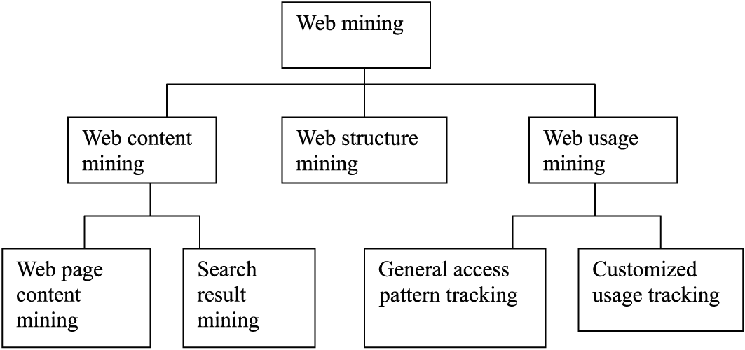
Web Mining

Slide 6
Web Content Mining
Web Content Mining is the process of extracting useful information from the contents of Web documents.
Content data corresponds to the collection of facts a Web page was designed to convey to the users.
May consist of text, images, audio, video, or structured records such as lists and tables.
Web content has been the most widely researched. Issues addressed in text mining are, topic discovery, extracting association patterns, clustering of web documents and classification of Web Pages.

Slide 7
Web Structure Mining
The structure of a typical Web graph consists of Web pages as nodes, and hyperlinks as edges connecting related pages.
Web Structure Mining is the process of discovering structure information from the Web. This can be further divided into two kinds based on the kind of structure information used.
Hyperlinks: A Hyperlink is a structural unit that connects a location in a Web page to different location, either within the same Web page or on a different Web page.
Document Structure: In addition, the content within a Web page can also be organized in a tree-structured format, based on the various HTML and XML tags within the page.

Slide 8
Web Usage Mining
Web Usage Mining is the application of data mining techniques to discover interesting usage patterns from Web data, in order to understand and better serve the needs of Web-based applications.
Usage data captures the identity or origin of Web users along with their browsing behavior at a Web site.
Web usage mining itself can be classified further depending on the kind of usage data considered:
Web Server Data
Application Server Data
Application Level Data

Slide 9
Challenges
Too huge for effective data warehousing and data mining.
Too complex and heterogeneous.
Growing and changing rapidly
Broad diversity of user communities.
Only small portion of the information on the web is truly relevant or useful.

Slide 10
The Page Rank Algorithm
The original Page Rank algorithm was described by Lawrence Page and Sergey Brin in several publications. It is given by
PR(A) = (1-d) + d (PR(T1)/C(T1) + ... + PR(Tn)/C(Tn))
Where:
PR(A) is the Page Rank of page A,
PR(Ti) is the Page Rank of pages Ti which link to page A,
C(Ti) is the number of outbound links on page Ti and
d is a damping factor which can be set between 0 and 1.

Slide 11
The Page Rank Algorithm
Page Rank does not rank web sites as a whole, but is determined for each page individually. Further, the Page Rank of page A is recursively defined by the Page Ranks of those pages which link to page A.
The Page Rank of pages Ti which link to page A does not influence the PageRank of page A uniformly. Within the Page Rank algorithm, the Page Rank of a page T is always weighted by the number of outbound links C(T) on page T. This means that the more outbound links a page T has, the less will page A benefit from a link to it on page T.

Slide 12
The Page Rank Algorithm
The weighted Page Rank of pages Ti is then added up. The outcome of this is that an additional inbound link for page A will always increase page A's Page Rank.
Finally, the sum of the weighted Page Ranks of all pages Ti is multiplied with a damping factor d which can be set between 0 and 1. Thereby, the extend of Page Rank benefit for a page by another page linking to it is reduced.

Slide 13
Time Series Data Mining
Consists of sequences of values or events obtained over repeated measurement of time at equal time interval in most of the time.
Used in application such as stock prediction, economic analysis etc.
In general, there are two goals in time series analysis.
Modeling Time Series: Generating the time series with underlying mechanism.
Forecasting Time Series: Predict the future values of the time series variables.

Slide 14
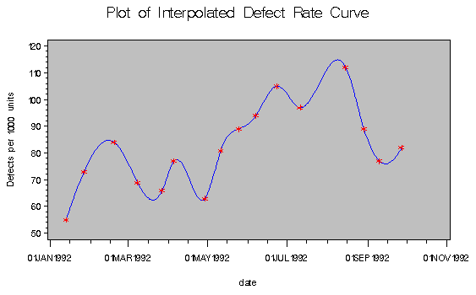
Time Series Data Mining

Slide 15
Major components for trend analysis in time series data
Trend or Long term Movements: Indicates the general direction in which a time series is moving over long or short interval of time through trend curve or trend line.
Cyclic Movement or Cyclic Variations: Long term oscillations about a trend curve or line which may or may not be periodic.
Seasonal Movements or Variations: These are systematic or calendar related. Eg. Sudden rise in sales of sweets in Tihar.
Irregular or Random Movements: Series due to random or chance events. Eg. Price rise in crisis of supply.

Slide 16
Approaches for time series data analysis
Regression analysis is commonly used for find trend in time series data.
Seasonal Index is used for analysis to adjust the reative values of a variable during the time series.
Autocorrelation analysis is applied between i^{ith} element of the series and the (i-k)^{th} element to detect seasonal patterns. Where K is referred to as the log.

Slide 17
Approaches for time series data analysis
Calculating the moving average of order n is the common method for determining trend.
Eg:
Original Data: 3 7 2 0 4 5 9 7 2
Moving average of order3: (3 + 7 + 2)/3 = 4, 3 2 3 6 7 6
Weighted (1, 4, 1) average: ((1*3 +4*7 +1*2)/(1+4 +1))
= 5.5, 2.5 1 3.5 5.5 8 6.5
Free hand method is used to draw approximate curve or line to fit a set of data based on user’s judgment.
Least square method is used to fit best curve.

